Slide 1
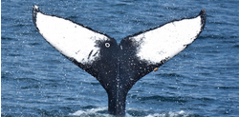
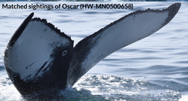
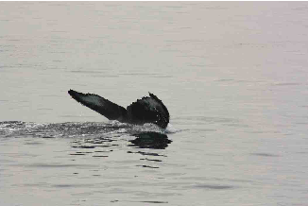
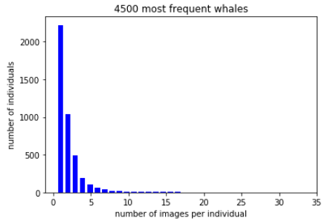
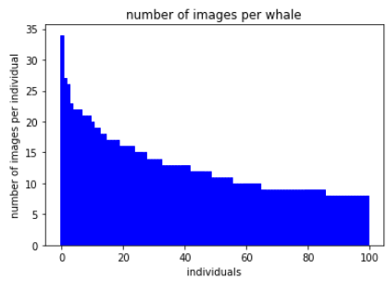
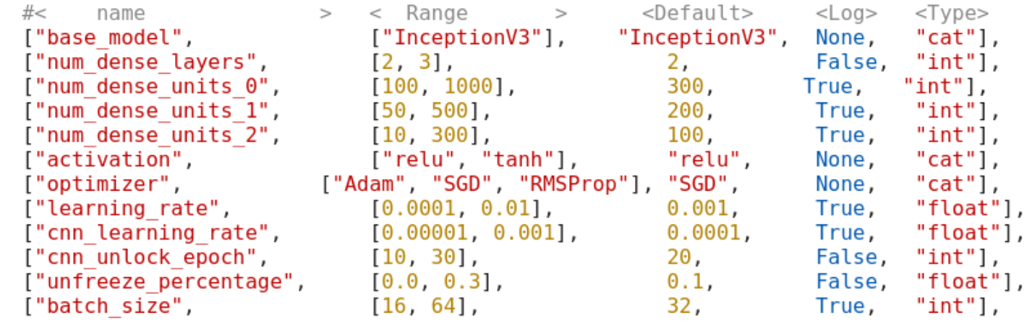
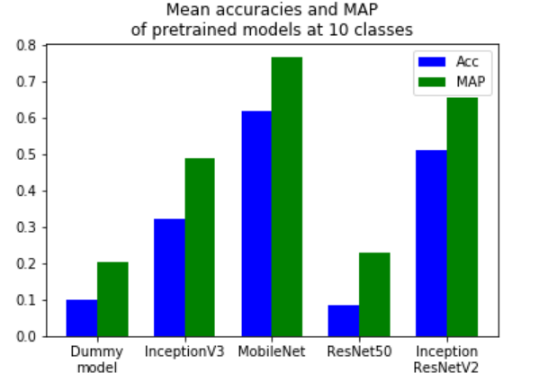
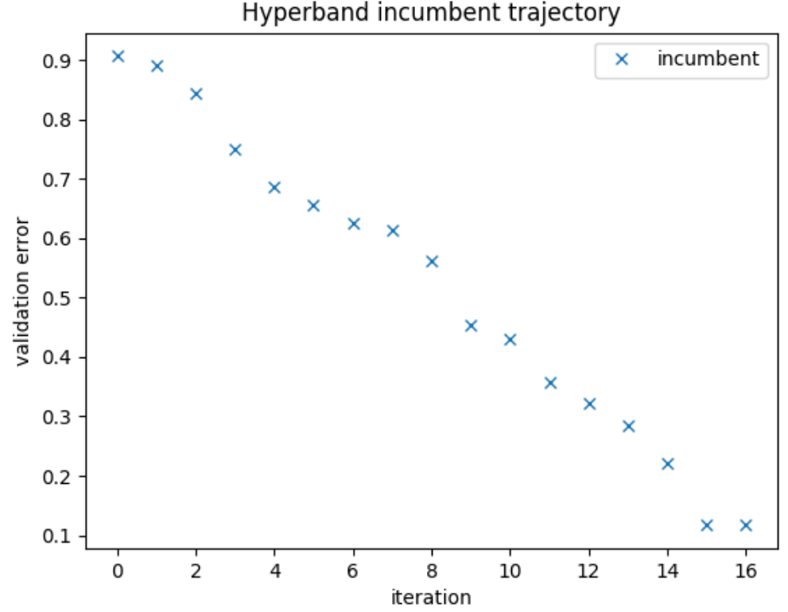
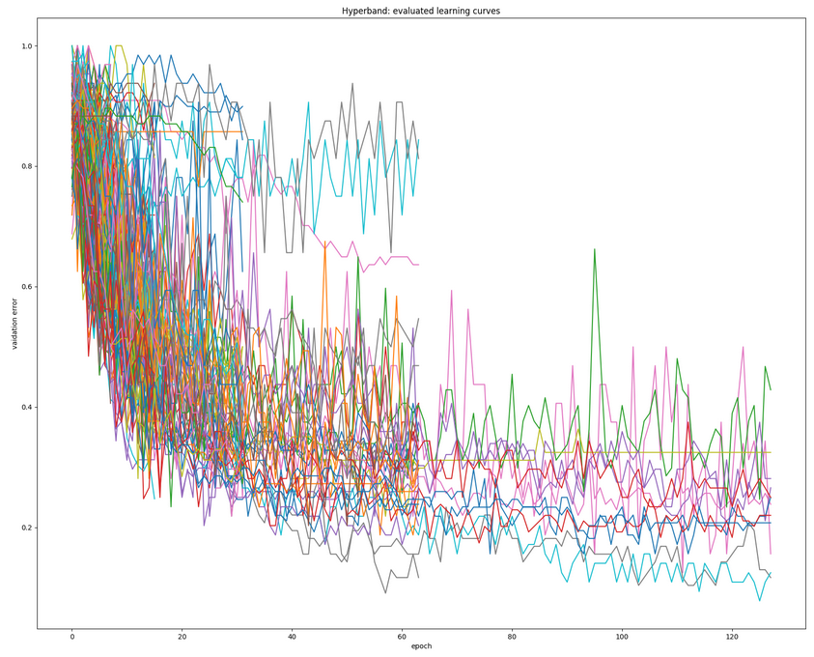
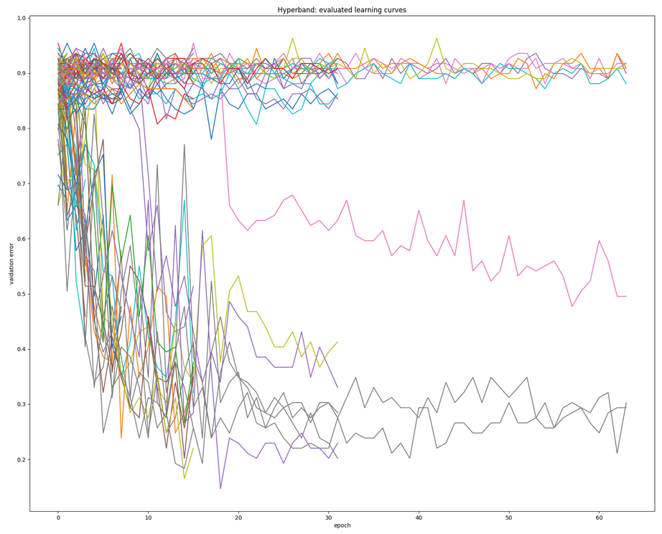
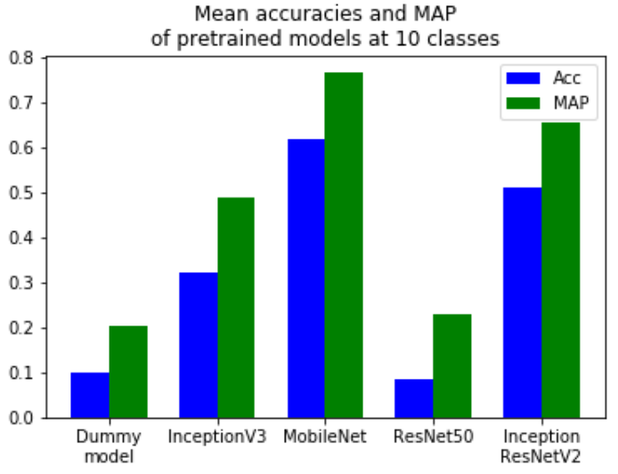
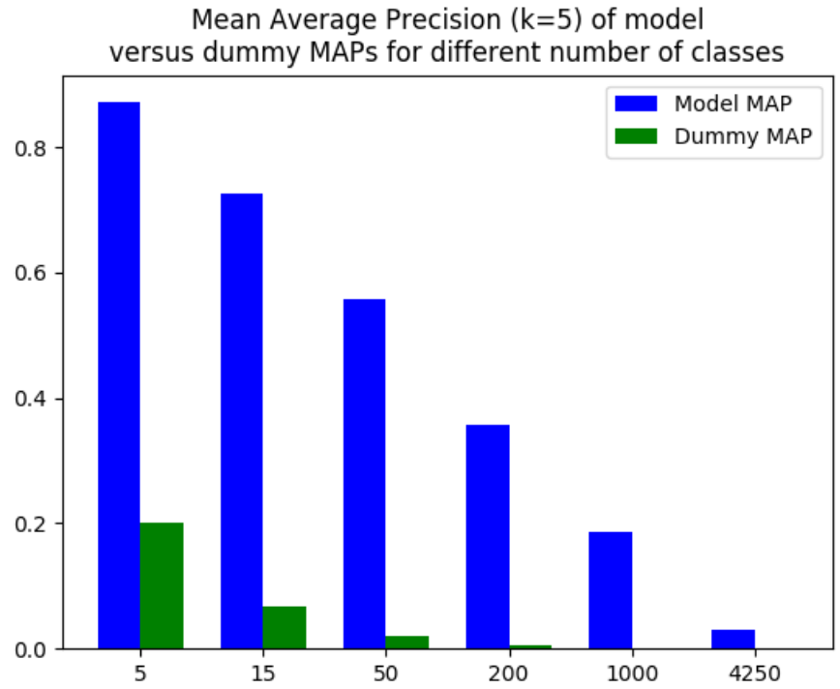
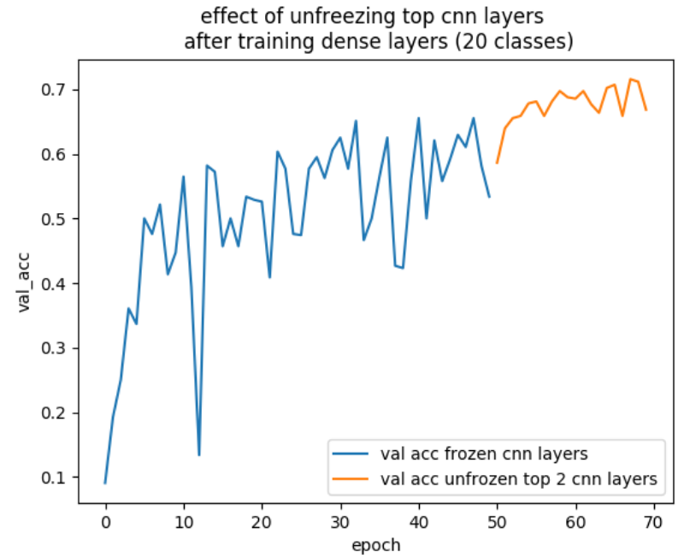
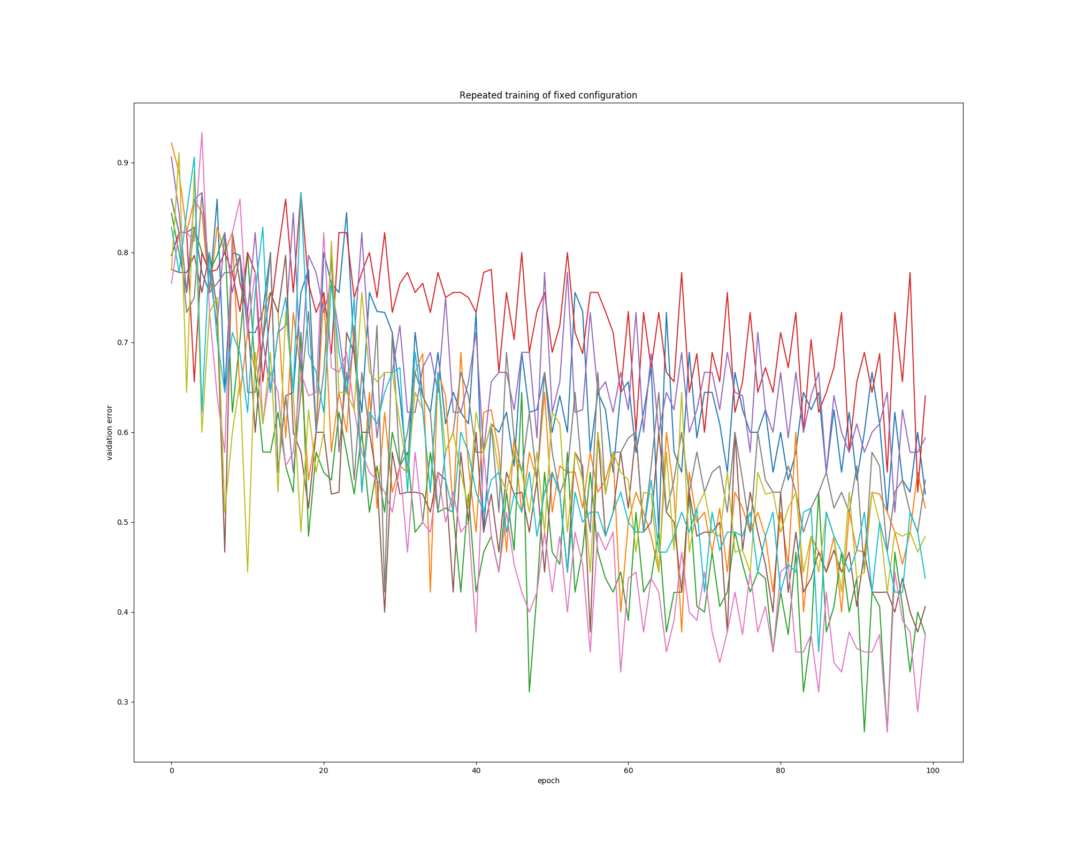
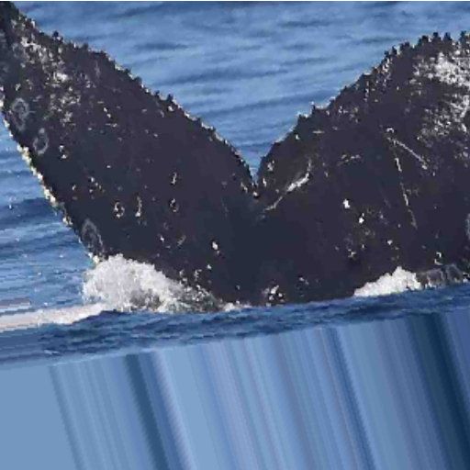
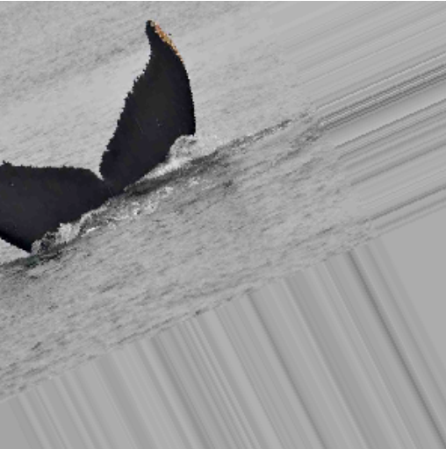
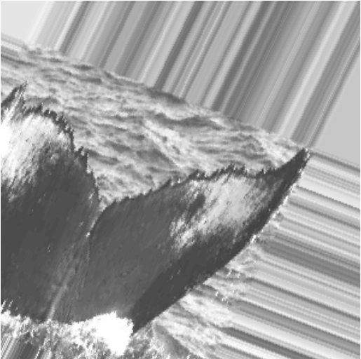
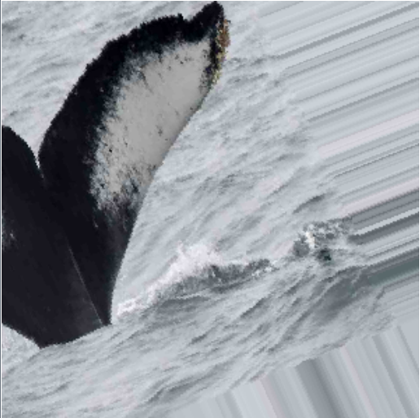
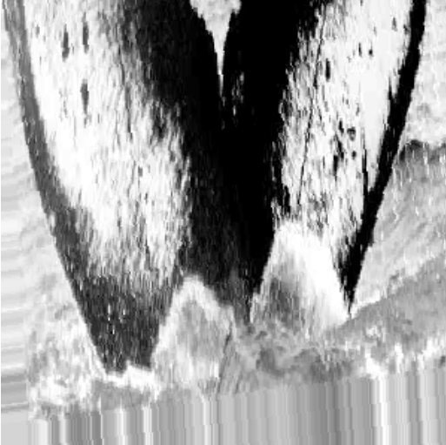
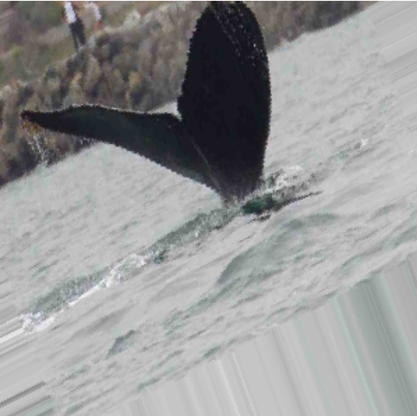
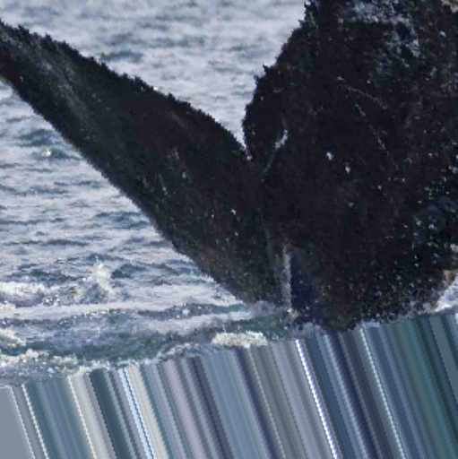
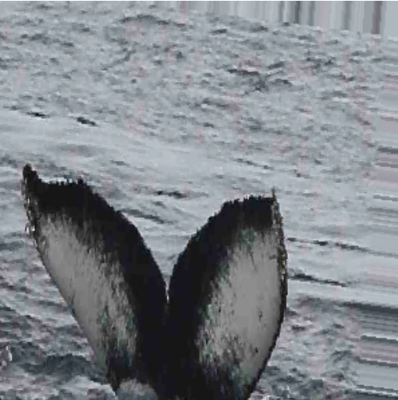
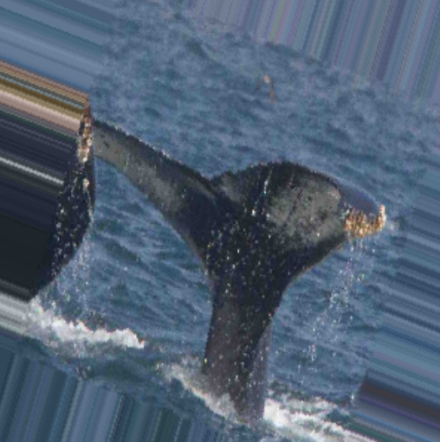
Humpback Whale Identification: a Kaggle competition
Fabian Glöckle, Jochen Sautter, Ben Wilhelm
The Challenge
40 years of scientific whale monitoring generated a large collection of images of tail flukes of Humpback whales
25,000 images were assigned to >4,000 individual whales by researchers
Try to recognize the whales by their flukes with a deep learning model
Statistics
Sparse and unevenly distributed data base:
9,500 labeled images of 4,500 whales as training data - 2,000 whales, where only one image is available - 1,000 whales with 2 images
15.000 images as test data
Images differ largely in - shape - resolution and quality - color / grayscale
Our Approach
Use large CNNs pretrained on image-net Database as provided by Keras
“Freeze” parameters of pretrained cnn base-models, and train on our classification task with 2-3 additional dense layers
Models: InceptionV3, Xception, ResNet50, MobileNet, InceptionResNetV2
After training of dense layers “unfreeze” some of the top layer-blocks of the cnn base-model and train more epochs
Use Data Augmentation: shifting, stretching, rotating
Optimize hyper parameter configuration using “HyperbandSter” framework
Results
Hyperband searching for training/network parameters
Hyperband searching for augmentation parameters
validation error
validation error
epoch
epoch
repeated training of fixed configuration
validation error
epoch
Notes:
<Foliennummer>

